Slide 1
Cryptography (2021 Fall) DES, double DES, meet-in-the-middle attack, triple DES
LiangFeng Zhang
zhanglf@shanghaitech.edu.cn
SIST, ShanghaiTech

Slide 2
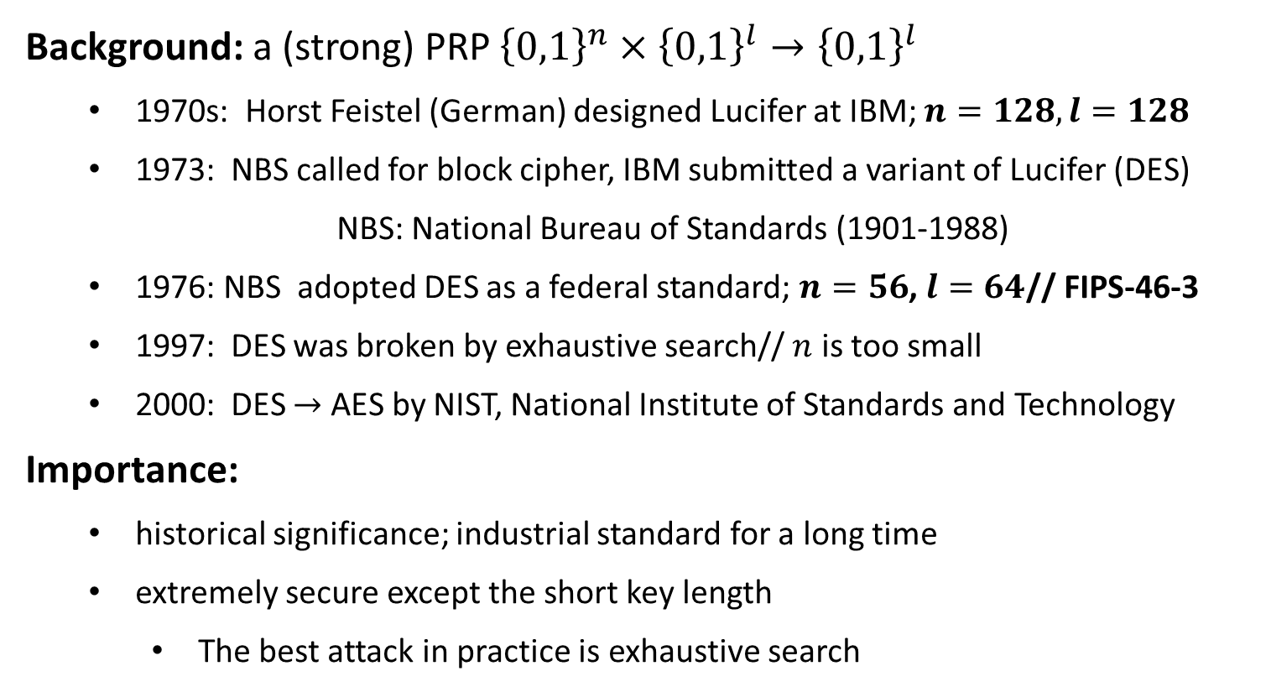
Data Encryption Standard (DES)
Background: a (strong) PRP ${\left\{0,1\right\}}^{n}×{\left\{0,1\right\}}^{l}→{\left\{0,1\right\}}^{l}$
1970s: Horst Feistel (German) designed Lucifer at IBM; $n=128, l=128$
1973: NBS called for block cipher, IBM submitted a variant of Lucifer (DES)
NBS: National Bureau of Standards (1901-1988)
1976: NBS adopted DES as a federal standard; $n=56$, $l=64$// FIPS-46-3
1997: DES was broken by exhaustive search// $n$ is too small
2000: DES $→$ AES by NIST, National Institute of Standards and Technology
Importance:
historical significance; industrial standard for a long time
extremely secure except the short key length
The best attack in practice is exhaustive search

Slide 3





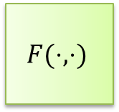












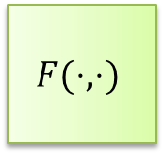


DES Encryption
$56$-bit
secret key $k$
key schedule
$48$-bit
$$k1$$
$$k2$$
$$⋯$$
$$k16$$
$$F(⋅,⋅)$$
$$F(⋅,⋅)$$
$$F(⋅,⋅)$$
$$m$$
$$IP$$
$$⋯$$
$$SW$$
$$IP^{−1}$$
$$c$$
$$L_{0},R_{0}$$
$$L_{1},R_{1}$$
$$L_{2},R_{2}$$
$$L_{16},R_{16}$$
$64$-bit
$64$-bit

Slide 4
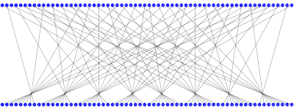
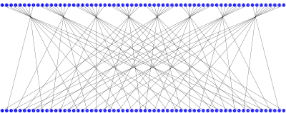
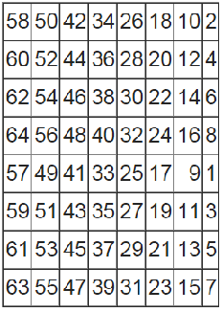
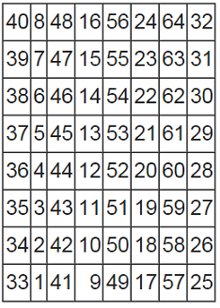





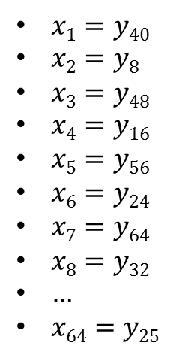
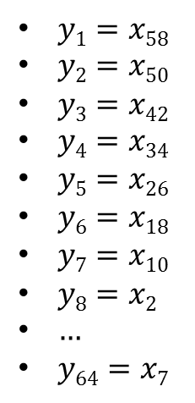

Initial Permutation IP
$$x=x1x2x3⋯x64$$
$$y=y1y2y3⋯y64$$
$$y=y1y2y3⋯y64$$
$$x=x1x2x3⋯x64$$
$$IP$$
$IP^{−1}$
$y1=x58$
$y2=x50$
$y3=x42$
$y4=x34$
$y5=x26$
$y6=x18$
$y7=x10$
$y8=x2$
$…$
$y64=x7$
$x1=y40$
$x2=y8$
$x3=y48$
$x4=y16$
$x5=y56$
$x6=y24$
$x7=y64$
$x8=y32$
$…$
$x64=y25$

Slide 5
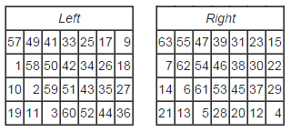
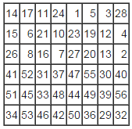








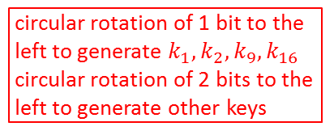







Key Schedule
64-bit key $K$
$$PC1$$
PC1
circular rotation of 1 bit to the
left to generate $k_{1},k_{2},k_{9},k_{16}$
circular rotation of 2 bits to the
left to generate other keys
28-bit
28-bit
<
<
28-bit
28-bit
PC2
48-bit $k1$
<
<
28-bit
28-bit
PC2
48-bit $k2$
64-bit $K→$ 56-bit $k$
<<
<<
$$PC2$$
28-bit
28-bit
PC2
48-bit $k3$
$$⋮$$
$$⋮$$
<
<
28-bit
28-bit
PC2
48-bit $k9$
<<
<<
28-bit
28-bit
PC2
48-bit $k10$
$$⋮$$
$$⋮$$
<
<
56-bit$→$48-bit
28-bit
28-bit
PC2
48-bit $k16$

Slide 6







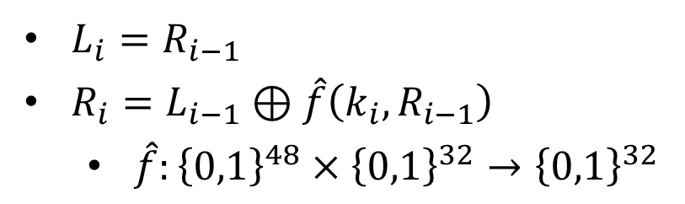
$$F(k_{i},L_{i−1}||R_{i−1})$$
32-bit
32-bit
$$L_{i−1}$$
$R_{i−1}$
$$⊕$$
$L_{i}=R_{i−1}$
$R_{i}=L_{i−1}⊕\hat{f}\left(k_{i}, R_{i−1}\right)$
$\hat{f}:{\left\{0,1\right\}}^{48}×{\left\{0,1\right\}}^{32}→{\left\{0,1\right\}}^{32}$
$$\hat{f}(k_{i},⋅)$$
$L_{i}$
$R_{i}$

Slide 7
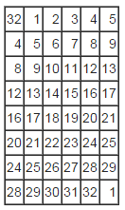
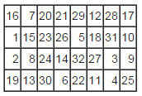
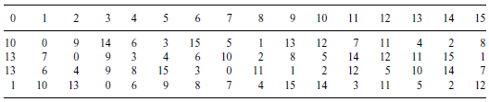



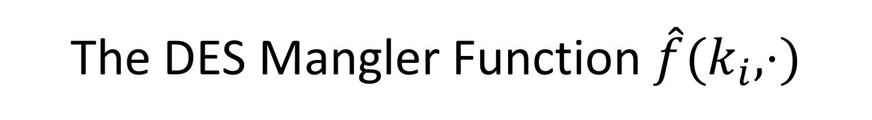



















The DES Mangler Function $\hat{f}(k_{i},⋅)$
$$32 bits$$
$$48 bits$$
$R_{i−1}$
$k_{i}$
$$E$$
$$48 bits$$
$$P$$
$$⊕$$
$$48 bits$$
$E$/ expansion function
$$S1$$
$$S2$$
$$S3$$
$$S4$$
$$S5$$
$$S6$$
$$S7$$
$$S8$$
$$32 bits$$
$$P$$
$$S3$$
$$\hat{f}(k_{i},R_{i−1})$$

Slide 8
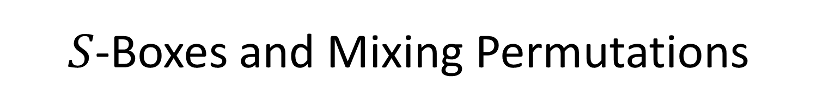
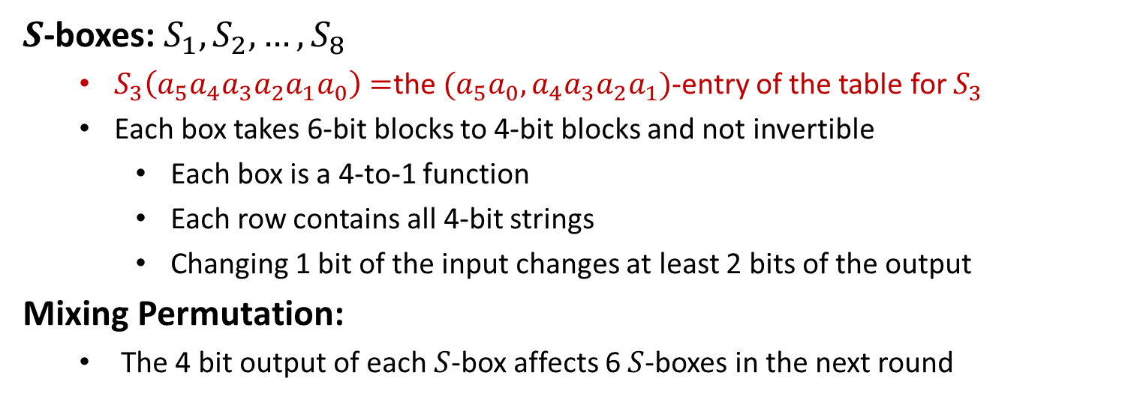
$S$-Boxes and Mixing Permutations
$S$-boxes: $S_{1}, S_{2},…,S_{8}$
$S_{3}\left(a_{5}a_{4}a_{3}a_{2}a_{1}a_{0}\right)=$the $(a_{5}a_{0},a_{4}a_{3}a_{2}a_{1})$-entry of the table for $S_{3}$
Each box takes 6-bit blocks to 4-bit blocks and not invertible
Each box is a 4-to-1 function
Each row contains all 4-bit strings
Changing 1 bit of the input changes at least 2 bits of the output
Mixing Permutation:
The 4 bit output of each $S$-box affects 6 $S$-boxes in the next round

Slide 9




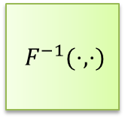


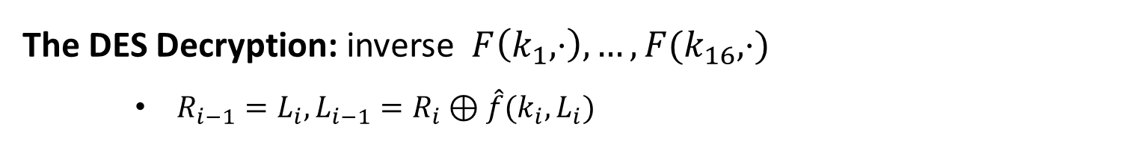




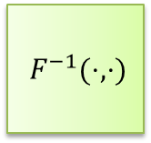








DES Decryption
$56$-bit
secret key $k$
key expansion
$48$-bit
$$k1$$
$$k2$$
$$⋯$$
$$k16$$
$F^{−1}(⋅,⋅)$
$F^{−1}(⋅,⋅)$
$F^{−1}(⋅,⋅)$
$$m$$
$$IP^{−1}$$
$$⋯$$
$$IP$$
$$SW$$
$$c$$
$$L_{0},R_{0}$$
$$L_{1},R_{1}$$
$$L_{2},R_{2}$$
$$L_{16},R_{16}$$
$64$-bit
$64$-bit
The DES Decryption: inverse $F\left(k_{1},⋅\right),…,F(k_{16},⋅)$
$R_{i−1}=L_{i}, L_{i−1}=R_{i}⊕\hat{f}(k_{i},L_{i})$

Slide 10
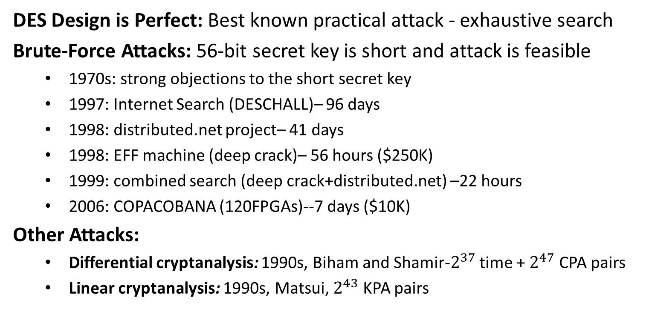
Security
DES Design is Perfect: Best known practical attack - exhaustive search
Brute-Force Attacks: 56-bit secret key is short and attack is feasible
1970s: strong objections to the short secret key
1997: Internet Search (DESCHALL)– 96 days
1998: distributed.net project– 41 days
1998: EFF machine (deep crack)– 56 hours ($250K)
1999: combined search (deep crack+distributed.net) –22 hours
2006: COPACOBANA (120FPGAs)--7 days ($10K)
Other Attacks:
Differential cryptanalysis: 1990s, Biham and Shamir-$2^{37}$ time + $2^{47}$ CPA pairs
Linear cryptanalysis: 1990s, Matsui, $2^{43}$ KPA pairs

Slide 11
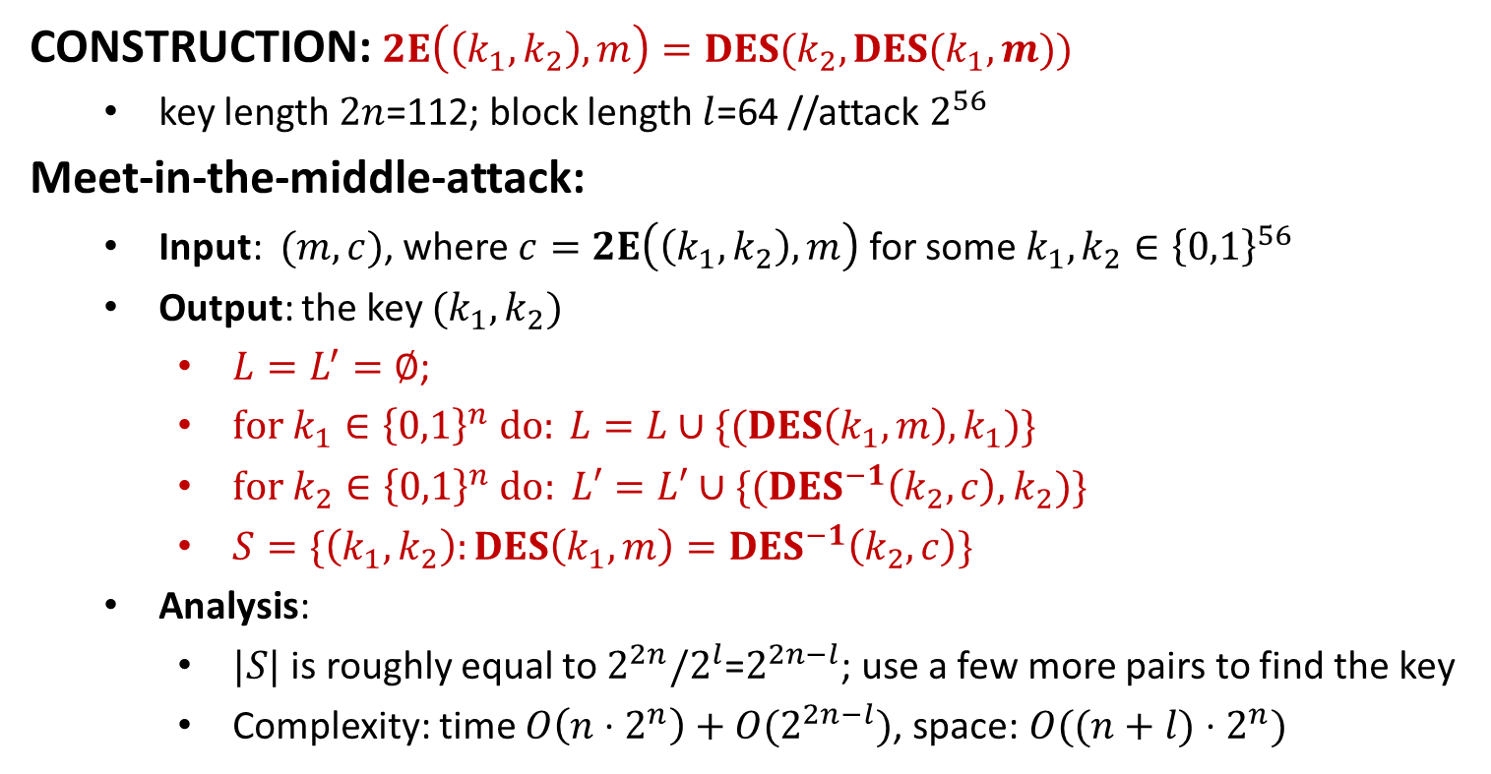
Double DES
CONSTRUCTION: $2E\left(\left(k_{1},k_{2}\right), m\right)=DES(k_{2},DES(k_{1},m))$
key length $2n$=112; block length $l$=64 //attack $2^{56}$
Meet-in-the-middle-attack:
Input: $(m,c)$, where $c=2E\left(\left(k_{1},k_{2}\right), m\right)$ for some $k_{1},k_{2}∈{\left\{0,1\right\}}^{56}$
Output: the key $(k_{1},k_{2})$
$L=L^{′}=∅$;
$for k_{1}∈{\left\{0,1\right\}}^{n} do: L=L∪\{(DES\left(k_{1},m\right),k_{1})\}$
$for k_{2}∈{\left\{0,1\right\}}^{n}$ $do: L′=L′∪\{(DES^{−1}\left(k_{2},c\right), k_{2})\}$
$S=\{\left(k_{1},k_{2}\right):DES\left(k_{1},m\right)=DES^{−1}\left(k_{2},c\right)\}$
Analysis:
$|S|$ is roughly equal to $2^{2n}/2^{l}$=$2^{2n−l}$; use a few more pairs to find the key
Complexity: time $O\left(n⋅2^{n}\right)+O(2^{2n−l})$, space: $O((n+l)⋅2^{n})$

Slide 12
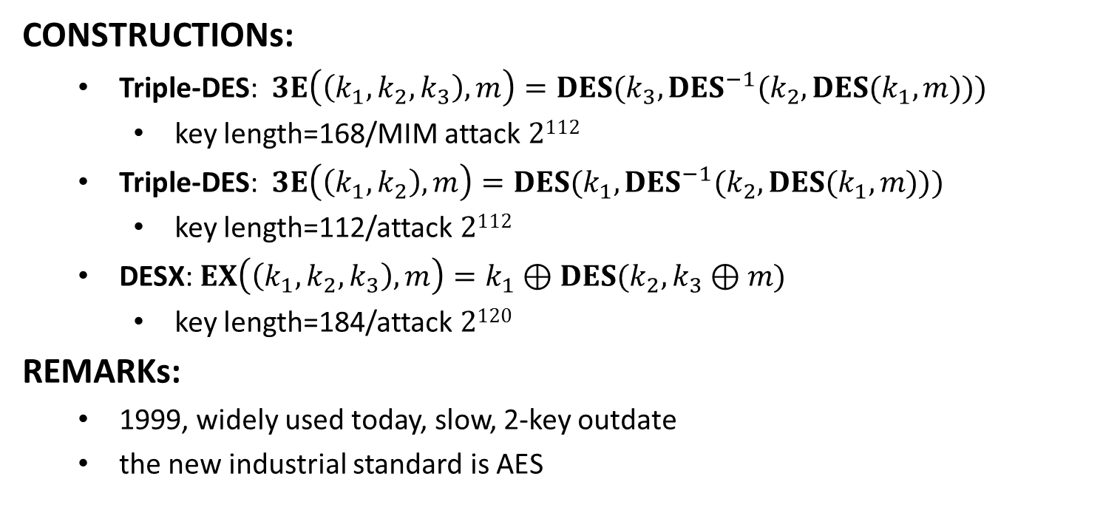
Triple DES
CONSTRUCTIONs:
Triple-DES: $3E\left(\left(k_{1},k_{2},k_{3}\right), m\right)=DES(k_{3},DES^{−1}(k_{2},DES(k_{1},m)))$
key length=168/MIM attack $2112$
Triple-DES: $3E\left(\left(k_{1},k_{2}\right), m\right)=DES(k_{1},DES^{−1}(k_{2},DES(k_{1},m)))$
key length=112/attack $2112$
DESX: $EX\left(\left(k_{1},k_{2},k_{3}\right),m\right)=k_{1}⊕DES(k_{2},k_{3}⊕m)$
key length=184/attack $2120$
REMARKs:
1999, widely used today, slow, 2-key outdate
the new industrial standard is AES

Slide 14
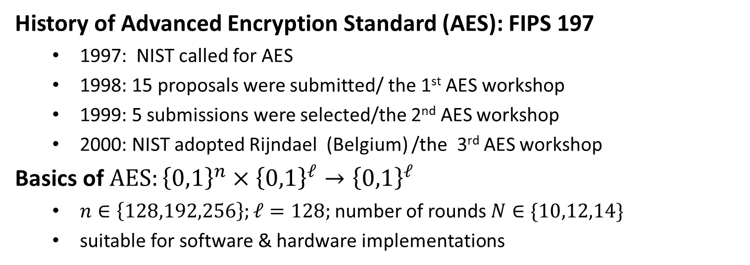
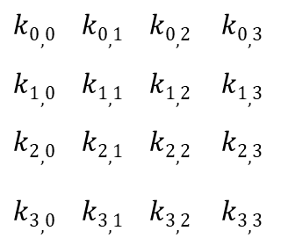
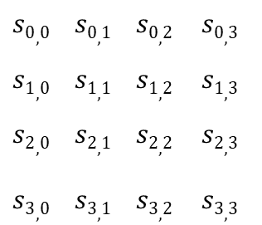
Advanced Encryption Standard
History of Advanced Encryption Standard (AES): FIPS 197
1997: NIST called for AES
1998: 15 proposals were submitted/ the 1st AES workshop
1999: 5 submissions were selected/the 2nd AES workshop
2000: NIST adopted Rijndael (Belgium) /the 3rd AES workshop
Basics of $AES:{\left\{0,1\right\}}^{n}×{\left\{0,1\right\}}^{ℓ}→{\left\{0,1\right\}}^{ℓ}$
$n∈\left\{128,192,256\right\};ℓ=128;$number of rounds $N∈\{10,12,14\}$
suitable for software & hardware implementations
$$s0,0 s0,1 s0,2 s0,3$$
$$s1,0 s1,1 s1,2 s1,3$$
$$s2,0 s2,1 s2,2 s2,3$$
$$s3,0 s3,1 s3,2 s3,3$$
$$k0,0 k0,1 k0,2 k0,3$$
$$k1,0 k1,1 k1,2 k1,3$$
$$k2,0 k2,1 k2,2 k2,3$$
$$k3,0 k3,1 k3,2 k3,3$$
128-bit
key version
State (16 bytes)
Key (16 Bytes)

Slide 15

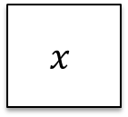



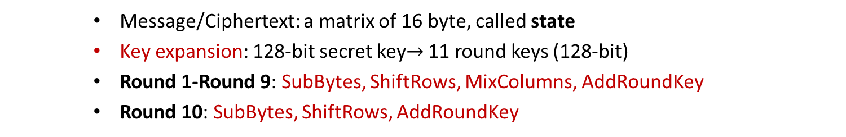

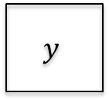
AES Encryption
128-bit
secret key $K$
Key expansion
$$K^{0}$$
$$K^{1}$$
$$K^{2}$$
$$K^{10}$$
128-bit round keys
AddRoundKey
4
4
SubBytes
ShiftRows
MixColumns
SubBytes
ShiftRows
MixColumns
SubBytes
ShiftRows
$$x$$
⨁
$$y$$
4
⨁
⨁
⨁
⨁
4
Round 1
Round 2
Round 10
Message/Ciphertext: a matrix of 16 byte, called state
Key expansion: 128-bit secret key$→$ 11 round keys (128-bit)
Round 1-Round 9: SubBytes, ShiftRows, MixColumns, AddRoundKey
Round 10: SubBytes, ShiftRows, AddRoundKey

